Slide 1
GIT & GITHUB COMPLETE GUIDE
NithishKumar L

Slide 2
After the installation of Git
Step 1 :- git config --global user.name “Name”
Step 2 :- git config --global user.email “Email”
Key Points :- Git is Nothing but VCS (Version Control System)

Slide 3
Cloning the remote repo into local Machine
Cmd :- git clone “URL”
Get the URL from the remote git repo
Key Points :- HEAD in git is a pointer which refers to the current branch.

Slide 4
Initializing the repo in Local Machine
Cmd :- git init
This command helps us to initialize the local repo by adding .git folder in your repo
This command is used when you are not using clone command

Slide 5
Remote repo
Cmd :- git remote –v
This command helps us view the remote repo for fetch and push.
Cmd :- git remote add origin <URL>
Cmd :- git remote add <name> <URL>
This two commands helps us to add the URL for PUSH and PULL

Slide 6
Local Repo to Remote Repo
Step 1
git add <filename>
Step 2
git commit –m “Msg”
Step 3
git push
(Or)
git add .

Slide 7
3 Basic command in Git
Cmd 1:- git add <filename>
This command helps to add file in staging area.
Cmd 2 :- git commit –m “Message”
This command helps to commit to local Repo
Cmd 3 :- git push
This command helps us to push into remote repo

Slide 8
Add and Commit
Cmd :- git commit -am “Message”
This command helps to add and commit at same time.

Slide 9
Git rm Command
Cmd :- git rm --cached <filename>
This command helps us to remove the file from the staging area.

Slide 10
Updating Local repo to latest Changes
Cmd :- git pull
This command helps to update the local repo if any changes done in remote repo

Slide 11
Git Fetch and Pull
Cmd :- git fetch
This command helps us to show the changes in the remote repo like a info it doesn’t alter your working directory.
Cmd :- git pull
This command helps us merge the changes from remote repo to local repo here local repo will be altered.

Slide 12
Git Branch Commands
Cmd :- git branch
This command displays the all the branches in the repo.
Cmd :- git branch <branch_name>
This Command creates the new branch

Slide 13
Git Branch Switch Commands
Cmd :- git switch <branch-name>
This command is used to Switch the branch.
Cmd:- git switch -c <branch-name>
This command is used to create and switch the branch.

Slide 14
Git Branch Checkout Commands
Cmd :- git checkout <branch-name>
This command is used to switch branch
Cmd :- git checkout -b <branch-name>
This command is used to create and switch the branch.

Slide 15
Git Branch Commands
Cmd :- git merge <branch-name>
This command helps to merge the current branch and the branch given in the command.
Cmd :- git branch -m <new-name>
This command is used to rename the branch.

Slide 16
Git Branch Commands
Cmd :- git merge <branch-name>
This command helps to merge the current branch and the branch given in the command.
Cmd :- git branch -m <new-name>
This command is used to rename the branch.

Slide 17
Git Merge Conflict
A merge conflict in Git occurs when Git is unable to automatically resolve differences between two branches being merged.
This usually happens when changes have been made to the same lines of a file, or when there are conflicting changes in different parts of the file that Git can't reconcile on its own.
Cause of Merge Conflicts:
Overlapping Changes: When two branches have changes in the same parts of a file, Git may not be able to determine which changes should be kept.
File Deletion and Modification: If one branch deletes a file while another branch modifies it, Git won't be able to decide how to integrate these differing actions.

Slide 18
Git Branch Delete Command
Cmd :- git branch -d <branch_name>
This command used to delete the branch
(Note:- You should not be in that branch in-order-to delete it)

Slide 19
Git diff Command
Cmd :- git diff
This command shows changes in the work directory and the staging area.
Cmd :- git diff HEAD
This command shows changes in the work directory and the last commit.
Cmd :- git diff HEAD <Filename>
This command is for specific file
Cmd :- git diff --staged or cached
This command shows changes or diff in the staging area and the last commit.
Cmd :- git diff --staged <Filename>
This command is for specific file

Slide 20
Git diff Command
Cmd :- git diff branch1..branch2
This command shows difference between two branches.
Cmd:- git diff commit1 commit2
This command shows difference between two commits
Note:- commit 1 and commit 2 are the Hashes of the commit.

Slide 21
Git stash Command
Cmd :- git stash
The command temporarily stores your working directory's modifications, allowing you to switch branches without discarding your current progress.
Cmd : git stash pop
This command helps to display the stacked changes that is disappeared from stash command.

Slide 22
Git Status & Log Command
Cmd :- git status
This command checks the untacked file and changes that are not staged.
Cmd :- git log
This commands shows the commit history
Cmd :- git log --oneline
This command shows the commit history in one line.
.

Slide 23
Git revert Command
Cmd :- git revert <commit-id>
This command helps us to revert or delete the commit.
This is useful when you want to undo the effects of a commit while preserving the history of changes.

Slide 24
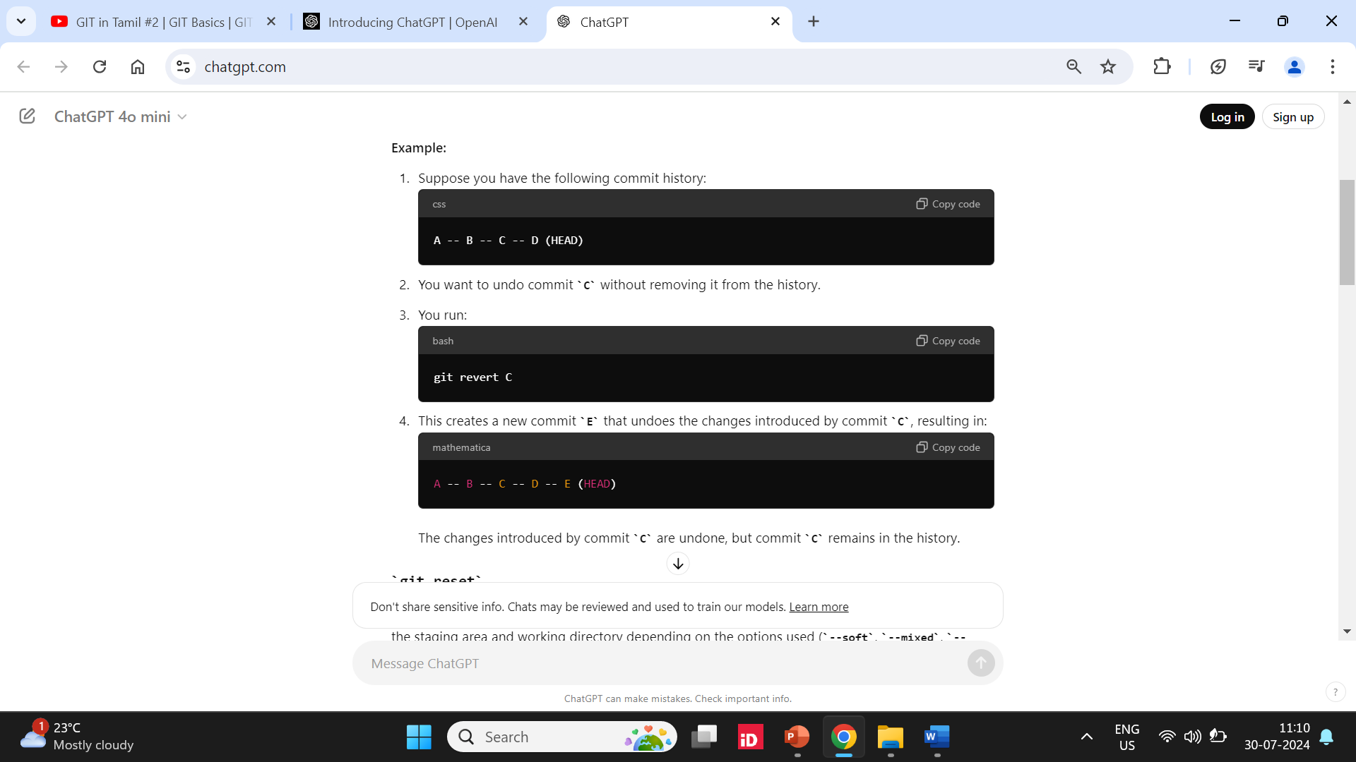
Git revert Command

Slide 25
Git reset Command
Cmd :- git reset --soft <commit-id>
This command goes back to the commit that have given.
Changes will be there in working directory and staging Area.
Cmd :- git reset --mixed <commit-id>
This command goes back to the commit that have given.
Changes will be there in working directory but not staged.
Cmd :- git reset -- hard <commit-id>
This command goes back to the commit that have given.
There will no trace of changes.

Slide 26
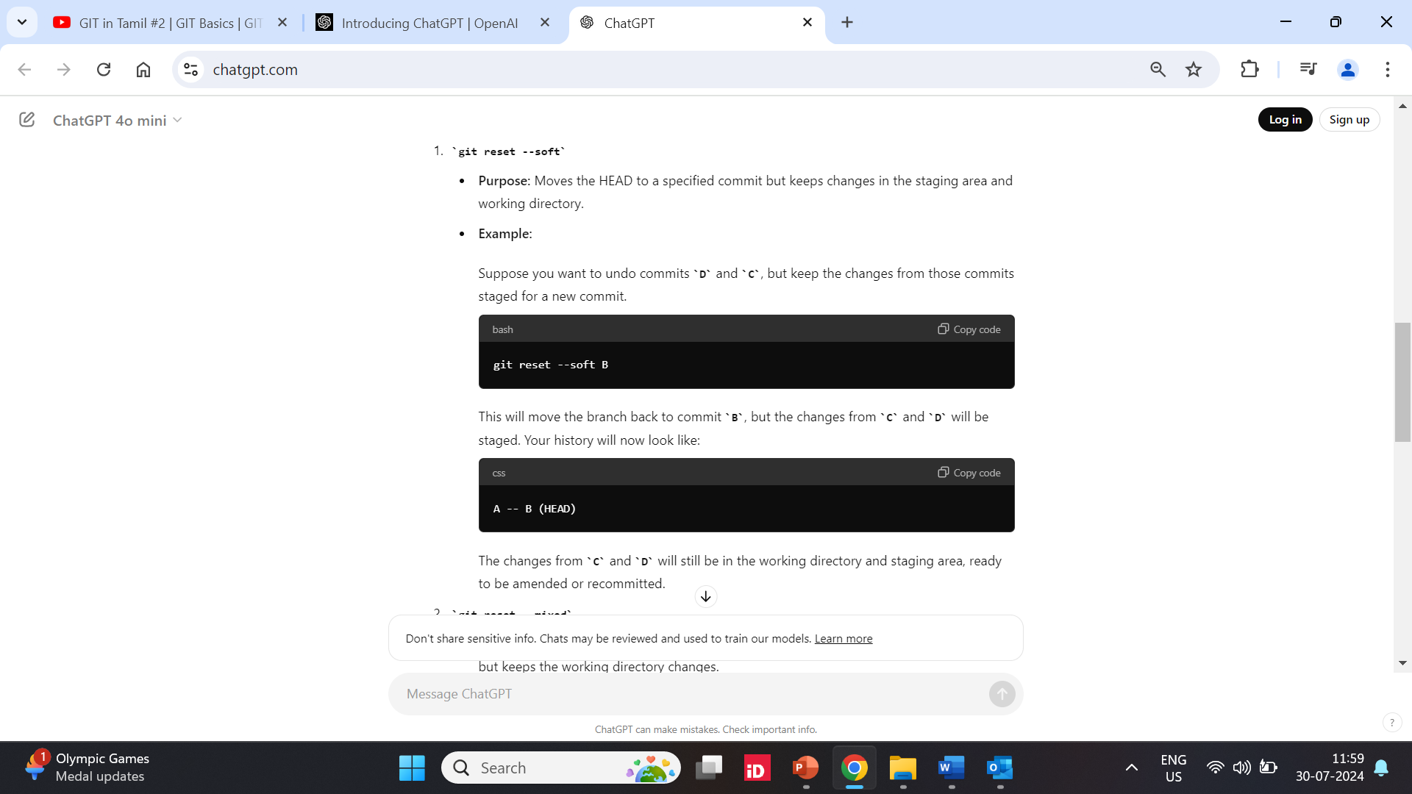
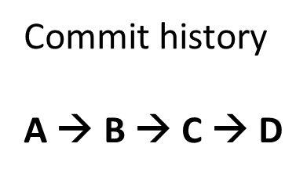
Git reset --soft Command

Slide 27
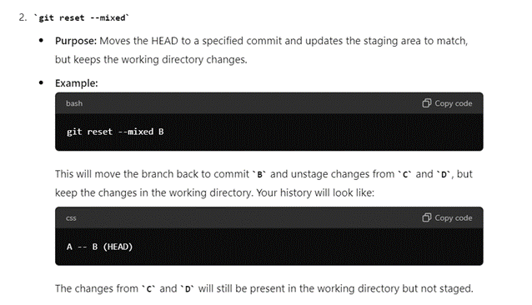
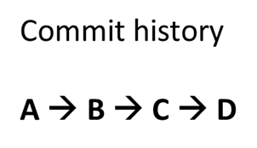
Git reset --mixed Command

Slide 28
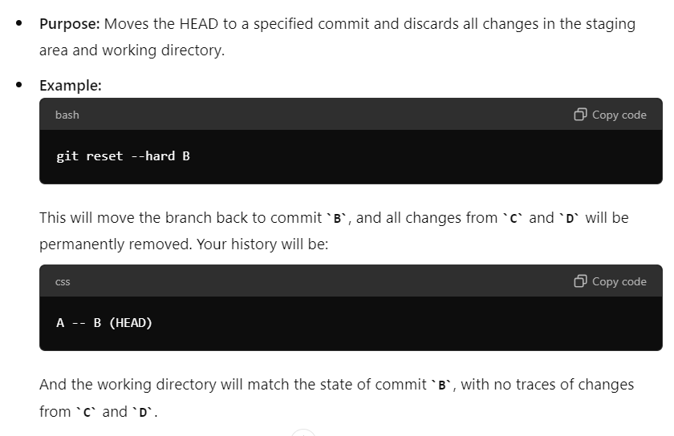
Git reset --hard Command

Slide 29
Git Rebase and Merge Command
difference between `git merge` and `git rebase` and when you would use each.
`git merge` integrates changes from one branch to another, preserving the history of both branches.
`git rebase` rewrites the history by placing commits from one branch onto another, creating a linear history.
Use `merge` to preserve the history of a feature branch, and `rebase` to clean up the commit history before merging.

Slide 30
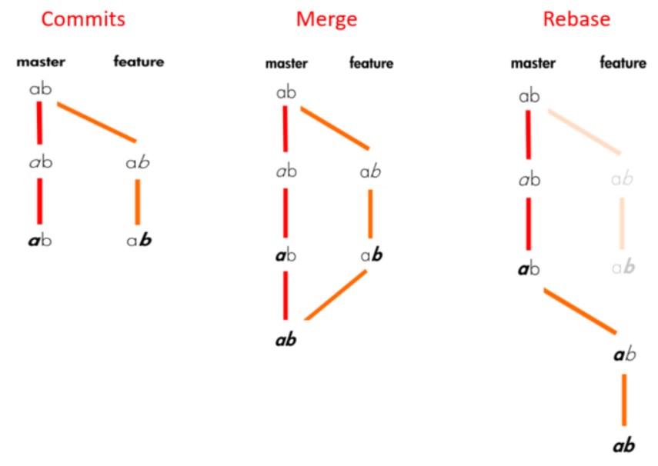
Git Rebase and Merge Command
.

Slide 31
Git .gitignore File
We can tell Git which files and directories to ignore in a given repository, using a .gitignore file.
This is useful for files you know you NEVER want to commit, including:
Secrets, API keys, credentials, etc.
Operating System files (.DS_Store on Mac)
Log files
Dependencies & packages

